Slide 1
Spring 2021
DATS 501 Fundamentals of Data Science
Cumhur Baştürk
basturkc.academic@gmail.com
Hasan Demirtaş
hasan.demirtas@yeditepe.edu.tr
hdemirtas.academic@gmail.com

Slide 2
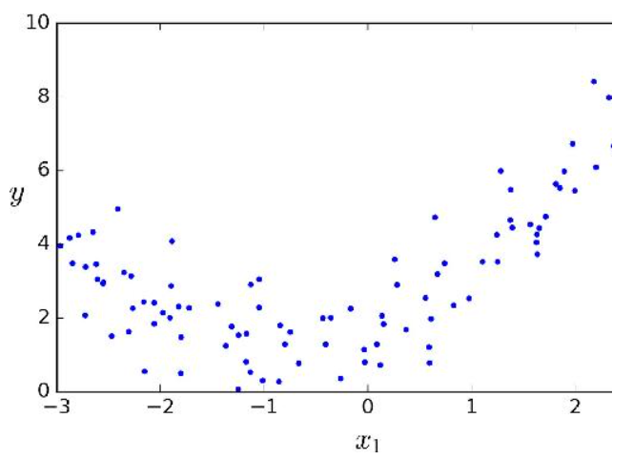
Polynomial Regression
What if your data is actually more complex than a simple straight line?
Surprisingly, you can actually use a linear model to fit nonlinear data. A simple way to do this is to add powers of each feature as new features, then train a linear model on this extended set of features. This technique is called Polynomial Regression.
Let’s look at an example. First, let’s generate some nonlinear data, based on a simple quadratic equation (plus some noise; see Figure):
A quadratic equation is of the form y = ax² + bx + c
Clearly, a straight line will never fit this data properly.
Adding the square (2nd-degree polynomial) of each feature in the training set as new features (in this case there is just one feature):

Slide 3
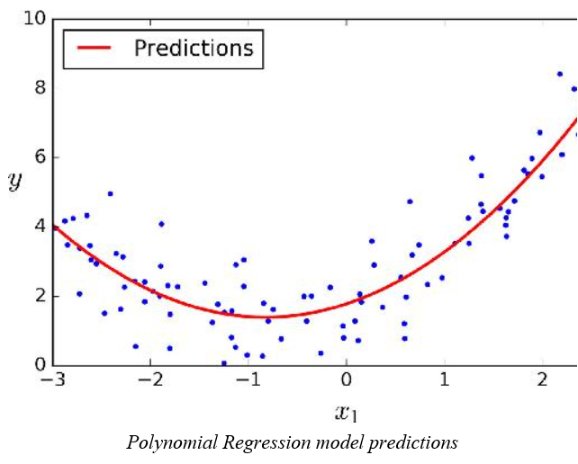
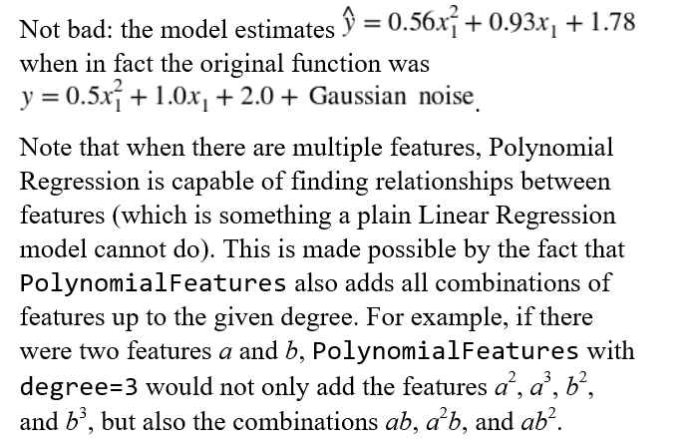
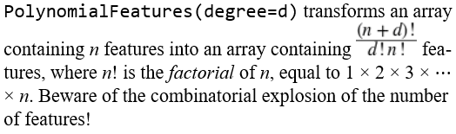
Polynomial Regression
WARNING

Slide 4
Polynomial Regression
Remember!
Bias
This part of the generalization error is due to wrong assumptions, such as assuming that the data is linear when it is actually quadratic. A high-bias model is most likely to underfit the training data
Variance
This part is due to the model’s excessive sensitivity to small variations in the training data. A model with many degrees of freedom (such as a high-degree polynomial model) is likely to have high variance, and thus to overfit the training data.
Tips
Against Bias
If your model is underfitting the training data, adding more training instances will not help. You need to use a more complex model or come up with better features.
Against High-Variance
One way to improve an overfitting model is to feed it more training data until the validation error reaches the training error. The other way is Regularization

Slide 5
Regularization
It is a good way to reduce overfitting (i.e., to constrain it): the fewer degrees of freedom it has, the harder it will be for it to overfit the data. For example, a simple way to regularize a polynomial model is to reduce the number of polynomial degrees.
For a linear model, regularization is typically achieved by constraining the weights of the model. We will now look at
Ridge Regression
Lasso Regression
Elastic Net
which implement three different ways to constrain the weights.

Slide 6
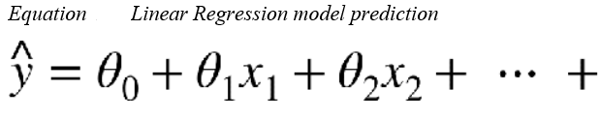
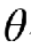
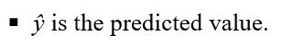
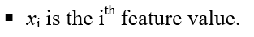
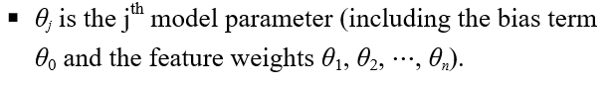
Regularization
A linear model makes a prediction by simply computing a weighted sum of the input features, plus a constant called the bias term (also called the intercept term), as shown in Equation

Slide 7
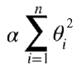
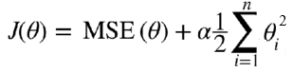
Regularization
Ridge Regression
Ridge Regression (also called Tikhonov regularization) is a regularized version of Linear Regression: a regularization term
is added to the cost function. This forces the learning algorithm to not only fit the data but also keep the model weights as small as possible.
Note that the regularization term should only be added to the cost function during training.
Once the model is trained, you want to evaluate the model’s performance using the unregularized performance measure.
The hyperparameter α controls how much you want to regularize the model.
If α = 0 then Ridge Regression is just Linear Regression.
If α is very large, then all weights end up very close to zero and the result is a flat line going through the data’s mean.
(large α: high bias/underfit, small α: high variance/overfit)
Equation presents the Ridge Regression cost function.

Slide 8
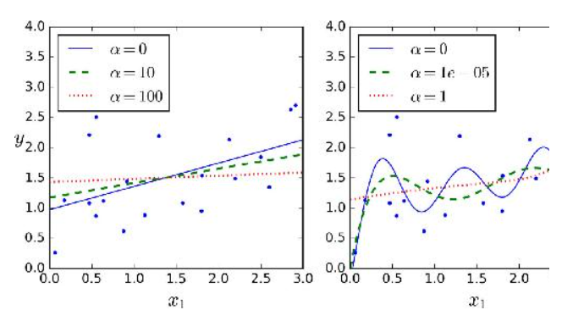
Regularization
Figure shows several Ridge models trained on some linear data using different α value.
On the left, plain Ridge models are used, leading to linear predictions.
On the right, the data is first expanded using PolynomialFeatures(degree=10), then it is scaled using a StandardScaler, and finally the Ridge models are applied to the resulting features: this is Polynomial Regression with Ridge regularization. Note how increasing α leads to flatter (i.e., less extreme, more reasonable) predictions; this reduces the model’s variance but increases its bias.

Slide 9
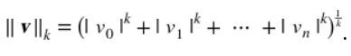
Regularization
The bias term θ₀ is not regularized (the sum starts at i = 1, not 0). If we define w as the vector of feature weights (θ₁ to θ_{n}), then the regularization term is simply equal to
½(∥ w ∥₂)²
where ∥ · ∥₂ represents the ℓ₂ norm of the weight vector.
norms, are:
Computing the root of a sum of squares (RMSE) corresponds to the Euclidian norm: it is the notion of distance you are familiar with. It is also called the ℓ₂ norm, noted ∥ · ∥₂ (or just ∥ · ∥).
Computing the sum of absolutes (MAE) corresponds to the ℓ₁ norm, noted ∥ · ∥₁. It is sometimes called the Manhattan norm because it measures the distance between two points in a city if you can only travel along orthogonal city blocks.
More generally, the ℓ_{k} norm of a vector v containing n elements is defined as
ℓ₀ just gives the cardinality of the vector (i.e., the number of elements

Slide 10
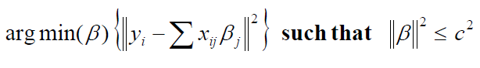
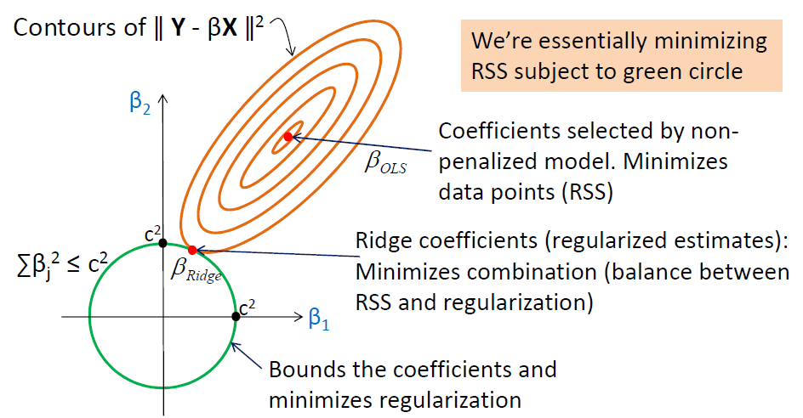
Regularization
ℓ₂ norm of the weight vector:
We want to bound the regression parameters by "c"(ℓ₂ norm)
A 2D example for illustration purposes (β1, β2):

Slide 11
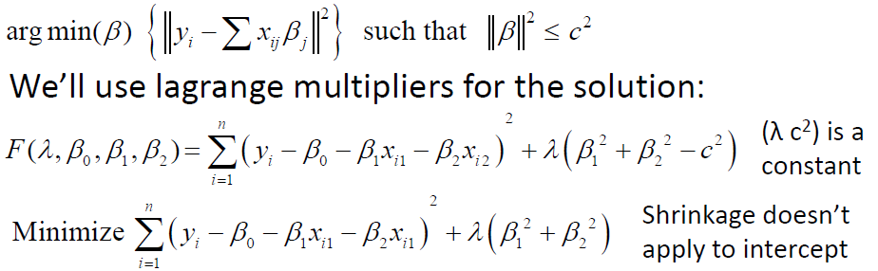
Regularization
Formal representation of Ridge regression:
Solution:
– Take the partial derivatives of F with respect to λ, β0, β1, β2 and solve for the system of equations
– Use a numerical method (find the parameters that minimize the function F for different λ’s) like Gradient Descent
– Use Cross Validation (split data set into training and test) and use the λ that minimizes test error
• Pros
– Works great for low signal datasets
– Good for multicollinearity
– Biased but smaller variance and smaller MSE
• Cons
– Shrinks coefficients to zero but cannot produce a parsiminous model (coefficients are all zero or not)
– Since Ridge regression has a circular constraint with no sharp points, this intersection will not generally occur on an axis, and so the ridge regression coefficient estimates will be non-zero
– Therefore not suitable for variable selection or for assessing the relative importance of each predictor.

Slide 12
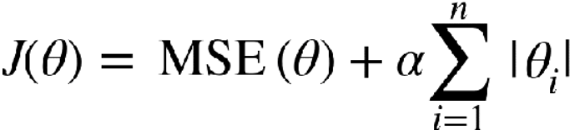
Regularization
Lasso Regression (Least Absolute Shrinkage & Selection Operator)
It is another regularized version of Linear Regression: just like Ridge Regression, it adds a regularization term to the cost function, but it uses the ℓ1 norm of the weight vector instead of half the square of the ℓ2 norm

Slide 13
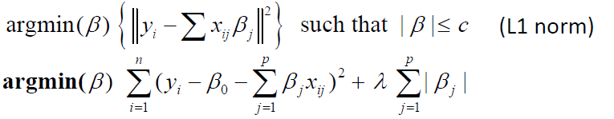
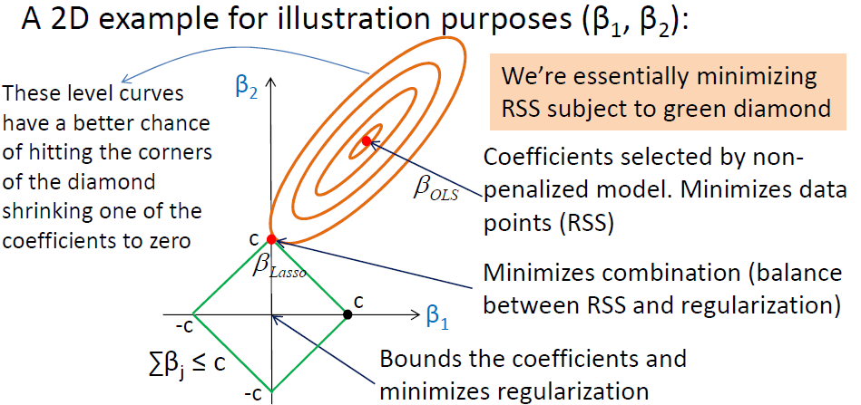
Regularization
Formal representation of Lasso regression:

Slide 14
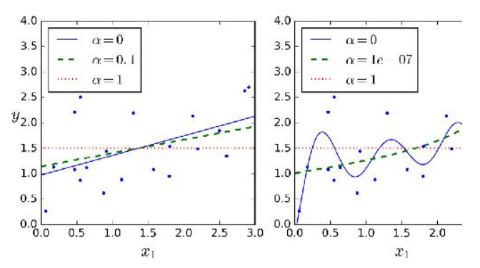
Regularization
An important characteristic of Lasso Regression is that it tends to completely eliminate the weights of the least important features (i.e., set them to zero). For example, the dashed line in the right plot on Figure (with α = 10⁻⁷) looks quadratic, almost linear: all the weights for the high-degree polynomial features are equal to zero. In other words, Lasso Regression automatically performs feature selection and outputs a sparse model (i.e., with few nonzero feature weights)

Slide 15
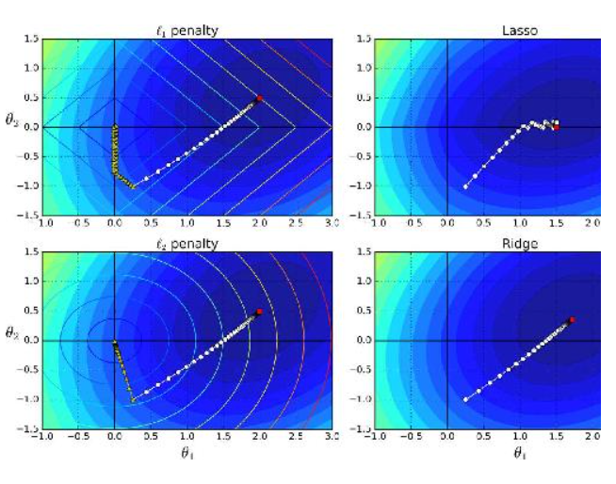
Regularization
You can see Lasso & Ridge Regression comparison by looking at Figure :
On the top-left plot, the background contours (ellipses) represent an unregularized MSE cost function (α = 0), and the white circles show the Batch Gradient Descent path with that cost function. The foreground contours (diamonds) represent the ℓ₁ penalty, and the triangles show the BGD path for this penalty only (α → ∞). Notice how the path first reaches θ₁ = 0, then rolls down a gutter until it reaches θ₂ = 0.
On the top-right plot, the contours represent the same cost function plus an ℓ₁ penalty with α = 0.5. The global minimum is on the θ₂ = 0 axis. BGD first reaches θ₂ = 0, then rolls down the gutter until it reaches the global minimum. The two bottom plots show the same thing but uses an ℓ₂ penalty instead. The regularized minimum is closer to θ = 0 than the unregularized minimum, but the weights do not get fully eliminated.

Slide 16
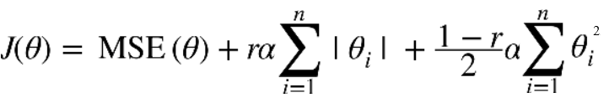
Regularization
Elastic Net
Elastic Net is a middle ground between Ridge Regression and Lasso Regression. The regularization term is a simple mix of both Ridge and Lasso’s regularization terms, and you can control the mix ratio r. When r = 0, Elastic Net is equivalent to Ridge Regression, and when r = 1, it is equivalent to Lasso Regression (see Equation)
So when should you use Linear Regression, Ridge, Lasso, or Elastic Net?
It is almost always preferable to have at least a little bit of regularization, so generally you should avoid plain Linear Regression. Ridge is a good default, but if you suspect that only a few features are actually useful, you should prefer Lasso or Elastic Net since they tend to reduce the useless features’ weights down to zero as we have discussed. In general, Elastic Net is preferred over Lasso since Lasso may behave erratically when the number of features is greater than the number of training instances or when several features are strongly correlated.

Slide 17
Regularization
Question 1:
Suppose you are using Ridge Regression and you notice that the training error and the validation error are almost equal and fairly high. Would you say that the model suffers from high bias or high variance? Should you increase the regularization hyperparameter α or reduce it?
Answer:
If both the training error and the validation error are almost equal and fairly high, the model is likely underfitting the training set, which means it has a high bias. You should try reducing the regularization hyperparameter α.
Question 2:
Why would you want to use:
Ridge Regression instead of Linear Regression?
Lasso instead of Ridge Regression?
Elastic Net instead of Lasso?
Answer:
A model with some regularization typically performs better than a model without any regularization, so you should generally prefer Ridge Regression over plain Linear Regression.
Lasso Regression uses an ℓ1 penalty, which tends to push the weights down to exactly zero. This leads to sparse models, where all weights are zero except for the most important weights. This is a way to perform feature selection automatically, which is good if you suspect that only a few features actually matter. When you are not sure, you should prefer Ridge Regression.
Elastic Net is generally preferred over Lasso since Lasso may behave erratically in some cases (when several features are strongly correlated or when there are more features than training instances). However, it does add an extra hyperparameter to tune. If you just want Lasso without the erratic behavior, you can just use Elastic Net with an l1_ratio close to 1.

Slide 18
Feature Selection
When we’re building a machine learning model, it is very important that we select only those features or predictors which are necessary. Suppose we have 100 features or predictors in our dataset. That doesn’t necessarily mean that we need to have all 100 features in our model. This is because not all 100 features will have significant influence on the model. But then again, this doesn’t mean it will be true for all cases. It depends entirely on the data we have in hand.
There are various ways in which you can find out which features have very little impact on the model and which ones you can remove from your dataset. we’ll look at Backward Elimination first and how we can do this, step by step.

Slide 19
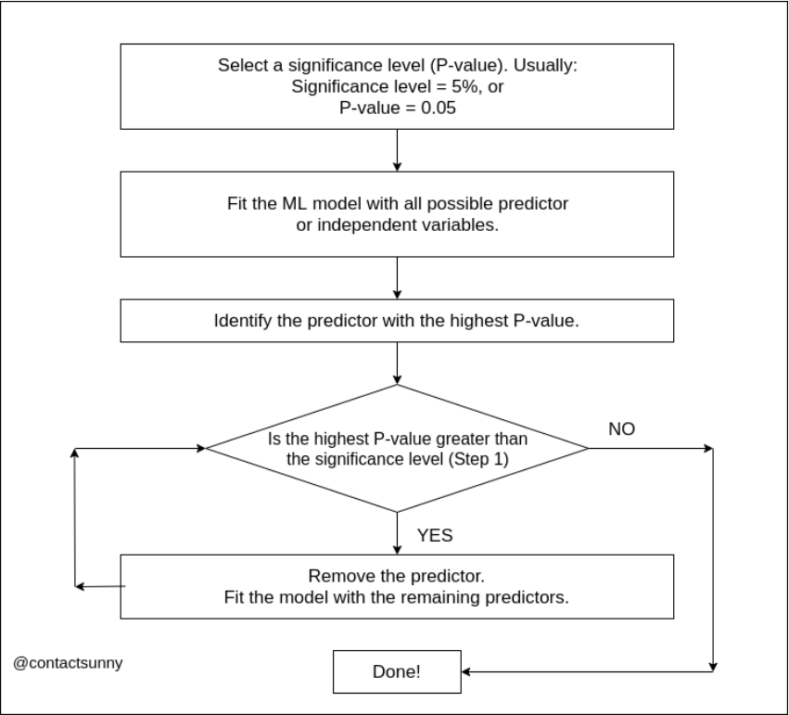
Feature Selection

Slide 20
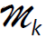
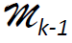
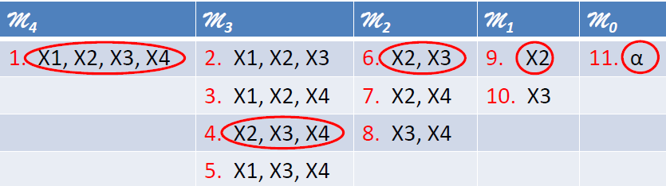
Feature Selection
For «m» predictors, we have 1+m(m+1)/2 models
– Example: For m=4, we’ll build 11 models
– For k=3,..,1, consider all k models that contain all but one of the predictors in for a total of k-1 predictors
– Pick the best (lowest p_value or lowest RSS or largest R2 ) among these k models and call it

Slide 21
Feature Selection
Forward Selection
Similar to backward elimination, even here we have a few steps to follow. We’ll go one by one as usual. But before going in, you need to know that this is going to be a bit more tedious of a job than backward elimination because you have to create a bunch of simple linear regression models here. And depending on the number of features you have in your dataset, the number of linear regression models you need to create could grow to a huge number pretty quickly.

Slide 22
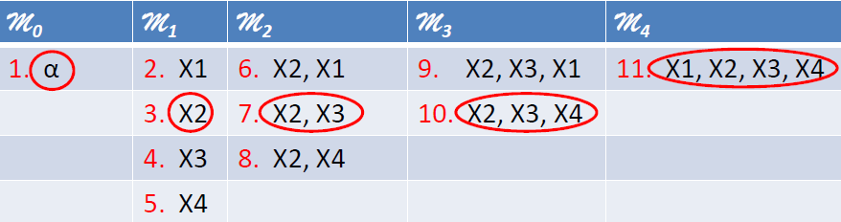
Feature Selection
For «m» predictors, we have 1+m(m+1)/2 models
– Example: For m=4, we’ll build 11 models
– For k=0,1,..,3, consider all 4-k models that augment the predictors in Mk with one additional factor
– Pick the best (lowest RSS or lowest p_value or largest R2) among these 4-k models and call it Mk+1

Slide 23
Feature Selection
Best Subset Selection
Uses all the combinations
It is 2^m for «m» features
Finds the best solution, however it is not applicable considering the size. 2^20 makes 1 million subsets. It is not practical to try 1 million model
Assuming it is applicable, can there be another problem?
Best solution is best for training (low bias)
Finding global optimum for training is not a guarantee for best test performance
As a result this method is never used ☺

Slide 24
Feature Selection
Stepwise (mixed) selection
More systematic criteria for choosing the best predictors by forward/backward stepwise selection
Start with no predictors in the model and add the predictor that yields the best fit (as in forward)
Keep adding predictors one by one (p-values will change as we add more predictors)
If the p-value at any point rises above a certain threshold for one of the predictors, remove it.
Keep doing these forward/backward steps until all predictors have sufficiently low p-values and all predictors kept out of the model have large p-values when added to the model.

Slide 25
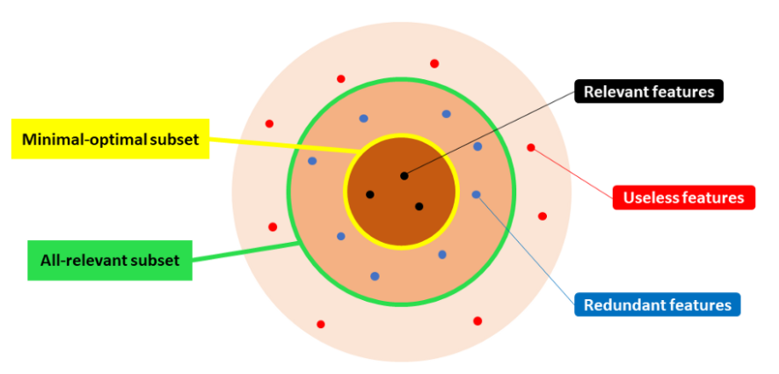
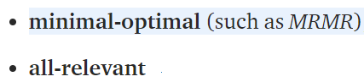
Feature Selection
"MRMR" (Maximum Relevance Minimum Redundancy)
Used for for finding the “minimal-optimal” subset of features.
Minimal-optimal vs. All-relevant
Feature selection algorithms can be broadly classified in two categories:
Thanks to Samuele Mazzanti

Slide 26
Feature Selection
Minimal-optimal methods seek to identify a small set of features that — put together — have the maximum possible predictive power. On the other hand, all-relevant algorithms are designed to select all the features that — individually — have any predictive power at all.
Thus, if feature A and feature B are both relevant, but they bring more or less the same information, an all-relevant method will select them both, whereas a minimal-optimal method will select only one of them and discard the other one.
This may seem a suitable distinction, but it makes a huge difference in practice. Imagine a scenario in which we have 10.000 features. You use »selection algorithms» and you find out that 5.000 of them have some kind of relationship with the target variable. But 5.000 is still an unmanageable number of features.
Is it possible to achieve the same (or often higher) accuracy with a far smaller model, for instance 50 features. But, how to choose them? Taking the top 50 features from »selection algorithms» doesn’t work. In fact, many of them may be highly correlated with each other: they wouldn’t add much information.
MRMR was developed to overcome this issue.

Slide 27
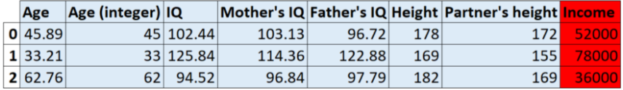
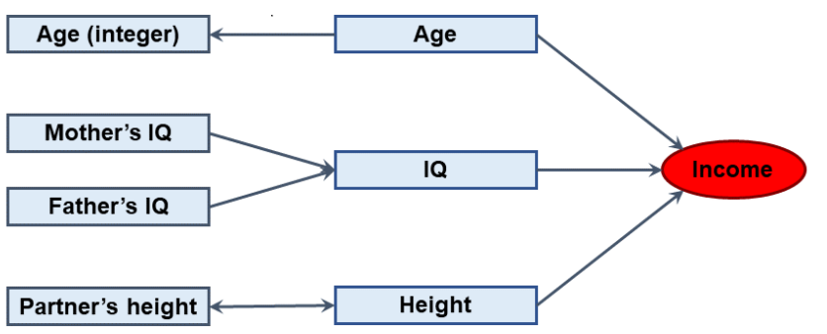
Feature Selection
“The best K features are not the K best features”
Let’s take a toy example. Say that our task is to predict the income of some people, knowing some of their (or their relatives’) characteristics. We dispose of these features:
Let’s also imagine that we know the causal relationships between the variables (this is a privilege that we don’t have often in real life, however it’s useful for understanding the logic behind MRMR).

Slide 28
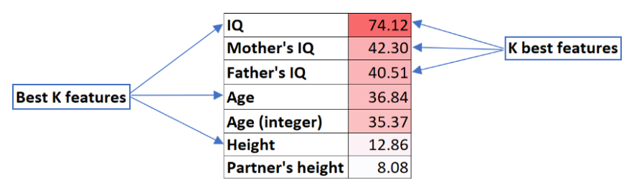
Feature Selection
Knowing the causal network would make feature selection ridiculously easy: we would choose {Age, IQ, Height}, since these are the only ones that have a direct causal relationship with the target variable. Adding any of the others would throw in unnecessary noise.
However, these are not necessarily the features that — taken individually — have the strongest predictive value with respect to the target variable. This is summarised by saying that:
The best K features are not the K best features.
What does this mean?
For instance, take Mother’s IQ: it’s not directly linked to Income, but it’s linked with IQ that is, in turn, heavily linked to Income. So, if you test it, you will find a quite strong relationship between Mother’s IQ and Income. But since we have already IQ in our model, there’s no point in keeping also Mother’ IQ.
In general terms, this implies that it’s not enough to look at individual measures of association between each feature and the target variable.

Slide 29
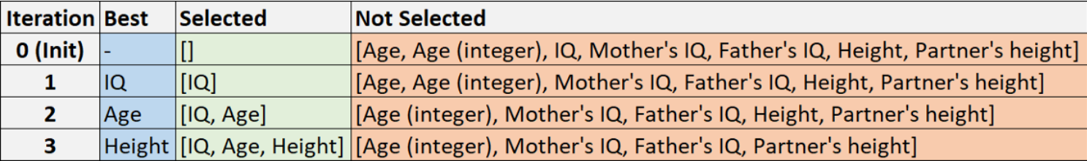
Feature Selection
Under the hood of MRMR
When using MRMR, you are basically required to make only one choice: deciding the number of features that you want to keep. We will call this number K. In our example, we will take K=3.
In real applications, one can choose K based on domain knowledge or other constraints, such as model capacity, machine memory or time available.
MRMR works iteratively. At each iteration, it identifies the best feature (according to a rule) and adds it to the basket of selected features. Once a feature goes into the bucket, it cannot ever come out.
In our example, these are the outcomes that we would get at the end of each iteration:

Slide 30
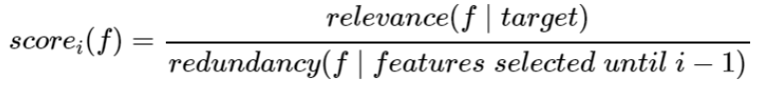
Feature Selection
What is the rule that determines the choice of the “Best” feature at each iteration
— namely IQ at step 1, Age at step 2 and Height at step 3? This is the core of MRMR.
“Maximum Relevance - Minimum Redundancy” is so called because — at each iteration — we want to select the feature that has maximum relevance with respect to the target variable and minimum redundancy with respect to the features that have been selected at previous iterations.
In practice, at each iteration i, a score is computed for each feature to be evaluated (f):
The best feature at iteration i is the one having the highest score. As simple as that.
The only question now is how to calculate the numerator and the denominator.

Slide 31
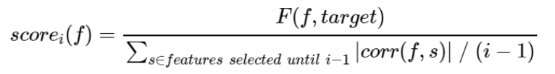
Feature Selection
The relevance of a feature f at the i-th iteration (numerator) is computed as the F-statistic between the feature and the target variable.
The redundancy (denominator) is computed as the average (Pearson) correlation between the feature and all the features that have been selected at previous iterations.
And the formula becomes:
where i is the i-th iteration, f is the feature that is being evaluated, F is F-statistic and corr is Pearson correlation. Note that correlation is taken in absolute value. In fact, if two features have correlation .9 or -.9 it makes no difference: in both cases they are highly redundant.
To make things even more explicit, imagine that we are at the 3rd iteration. This is what happened previously:
IQ has been selected at the 1st iteration;
Age has been selected at the 2nd iteration.
Which feature should we select next?
All we need to compute the score of each feature are the F-statistics and the correlations:

Slide 32
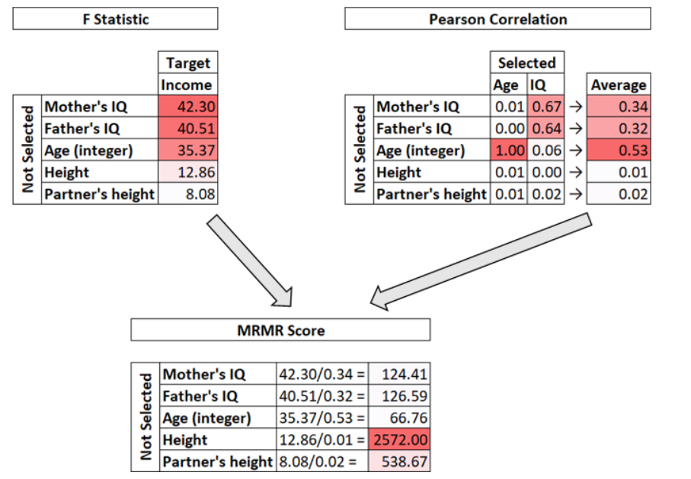
Feature Selection
As we said above, the next best feature is the one with the highest score, in this case Height.

